Slide 1

DESIGN AND CONSTRUCTION OF A MOBILE CONTROL ROBOT ARM ON A ROBOTIC WHEEL
SUPERVISOR
DR. P.K OLULOPE
OKE IYANUOLUWA E.
17BD005101

Slide 2
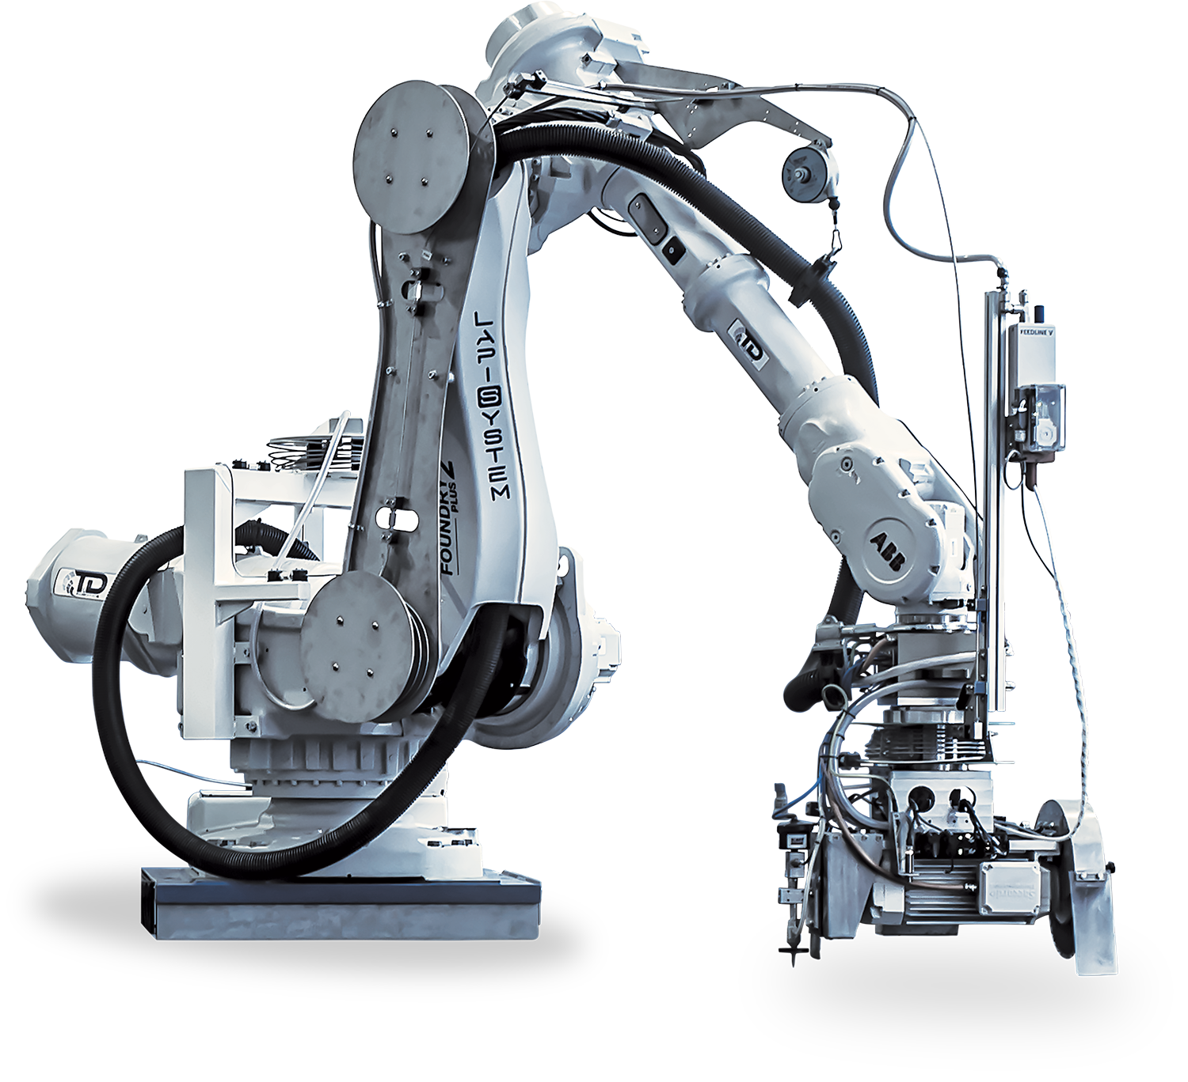
INTRODUCTION
Robot, any automatically operated machine that replaces human effort, though it may not resemble human beings in appearance or perform functions in a humanlike manner.
Three Laws of Robotics:
A robot may not injure a human being, or, through inaction, allow a human being to come to harm.
A robot must obey the orders given it by human beings except where such orders would conflict with the First Law.
A robot must protect its own existence as long as such protection does not conflict with the First or Second Law.
Hydroponic farming is a method of growing plants in water, not in soil.
Reasons for Hydroponic Farming:
LESS LAND USAGE
YOU CAN GROW PRODUCE YEAR-ROUND
LESS WATER USAGE
LOWER LABOUR REQUIREMENTS

Slide 3
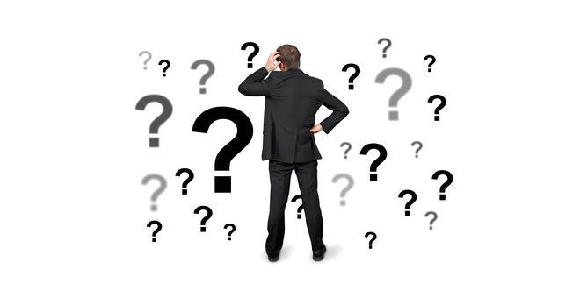
STATEMENT OF PROBLEM
Robotic advancements will reduce the number of high-end precision tasks and will benefit a variety of industries, including agriculture, military, and health care. As a result, robots will be used as workplace assistants with a degree of balance between genuine requirements and greed. Many jobs that are beyond human capability can be accomplished with the aid of robotics, which will be quite beneficial in its functioning.

Slide 4
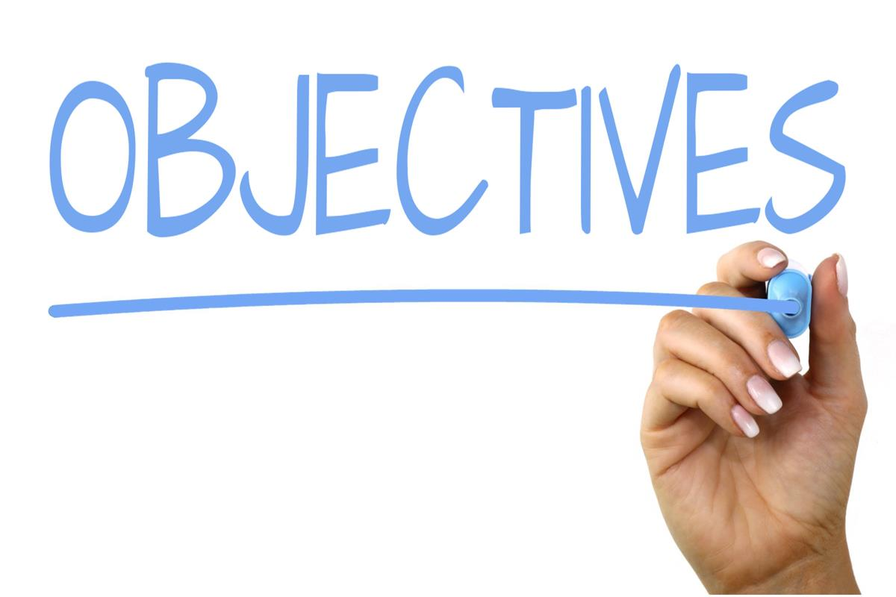
AIM & OBJECTIVES
AIM:
To develop a low-cost research robot used in any area of field.
OBJECTIVES:
To design an inexpensive system that is user-friendly and easy to use.
To construct a mobile app control robot for research purpose.
To develop an internet base control system that enables transfer and receiving data through the internet.
To interface the system with an internet android application enabling cloud data communication.

Slide 5
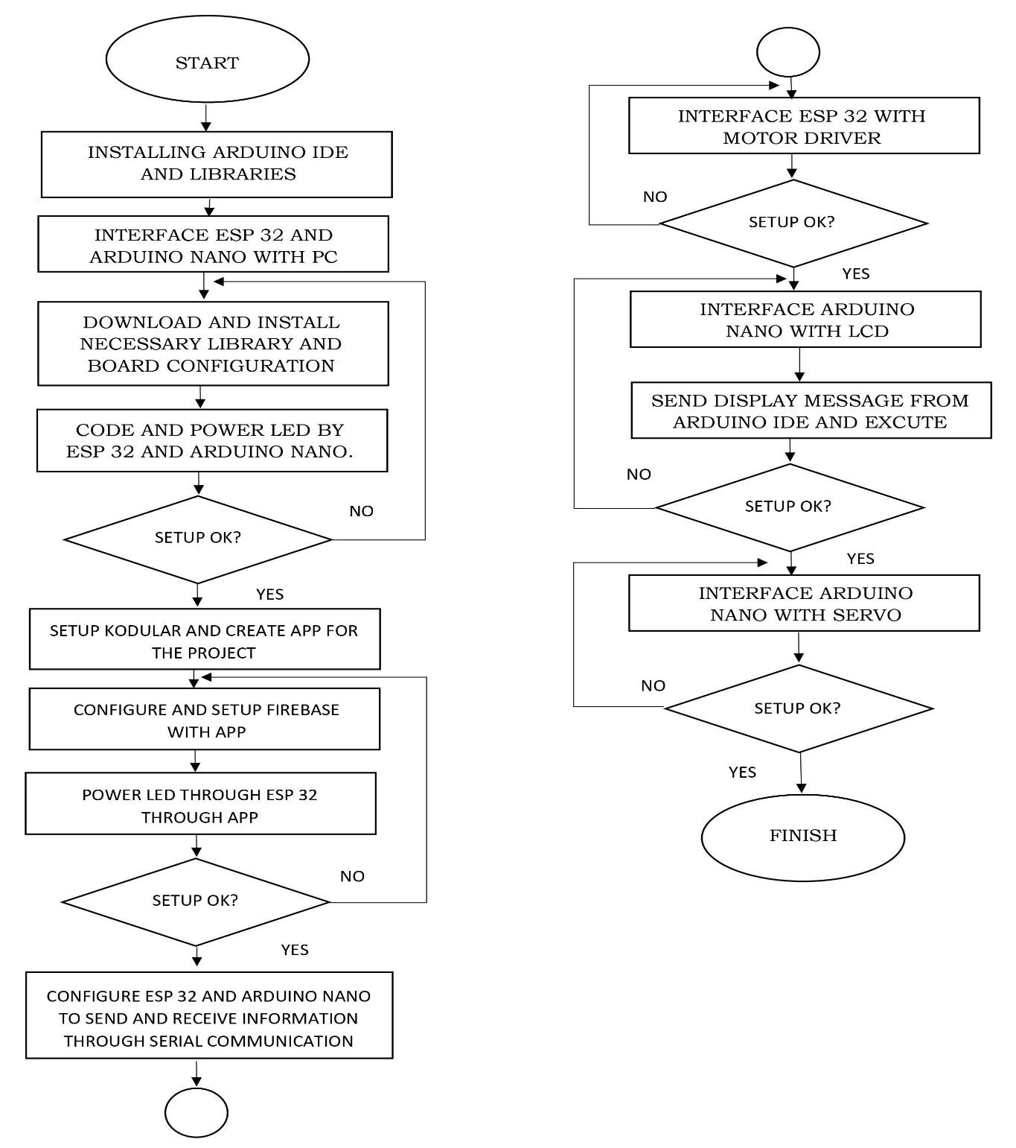
Methodology

Slide 6
Methodology

Slide 7
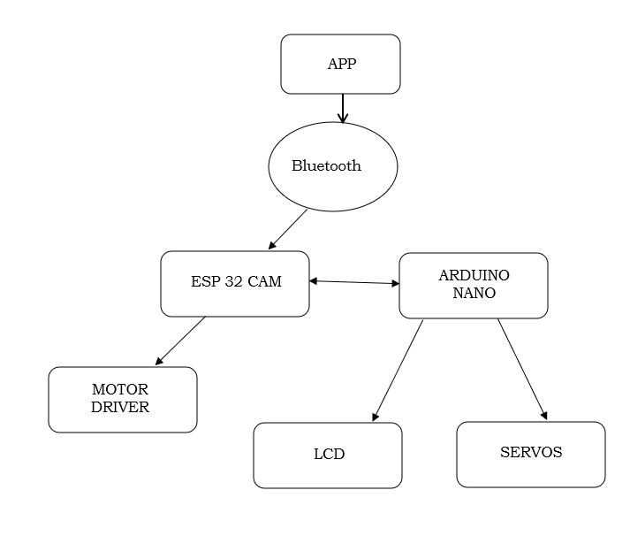

SYSTEM DESIGN

Slide 8
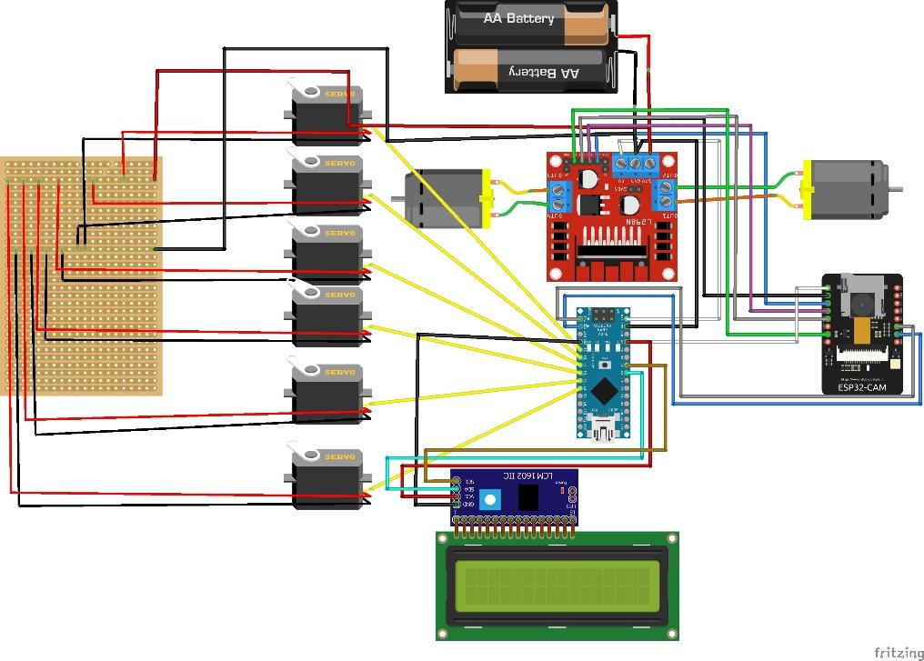

PICTORIAL CIRCUIT DIAGRAM

Slide 9
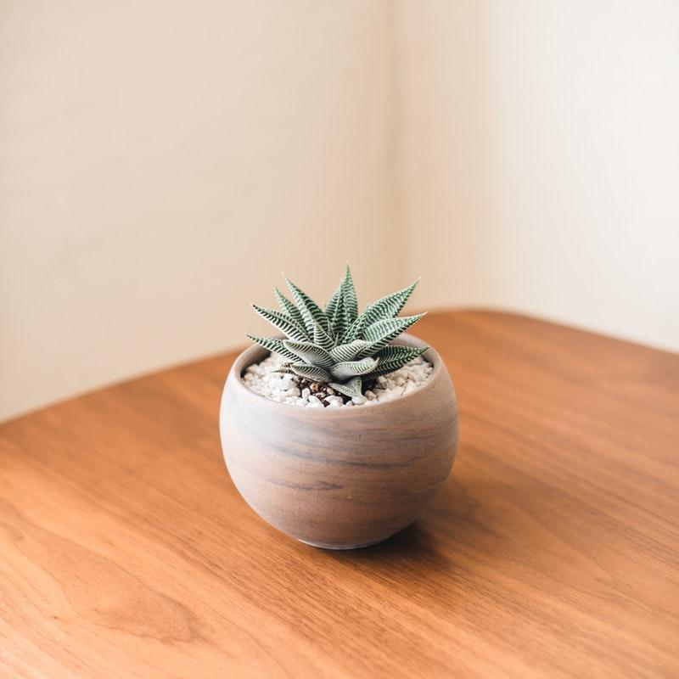
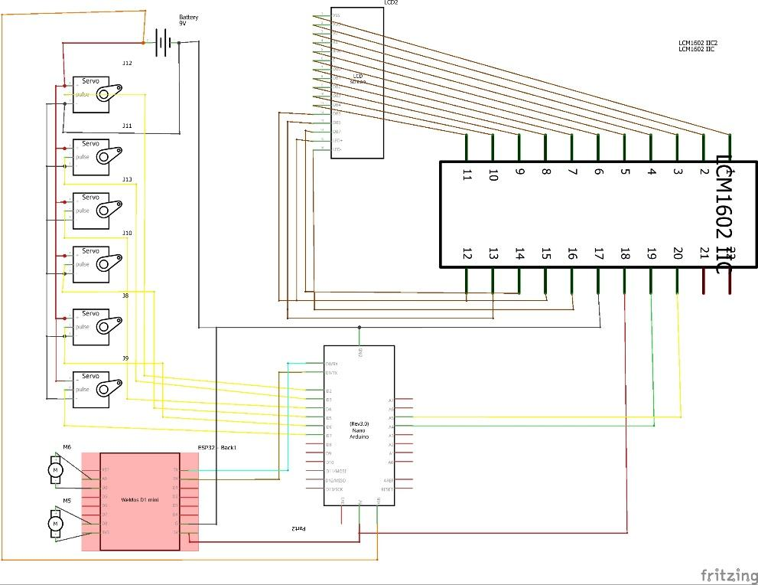
CIRCUIT DIAGRAM DESIGN

Slide 10
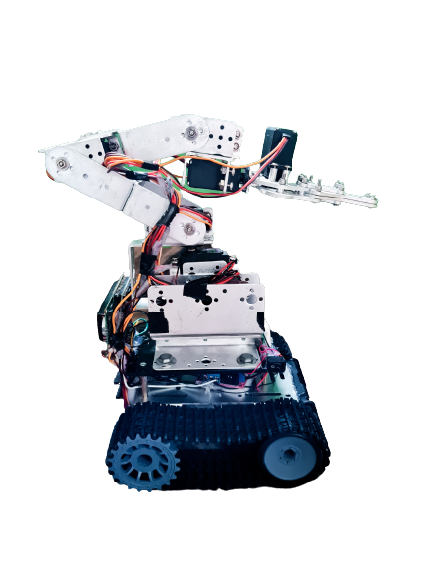
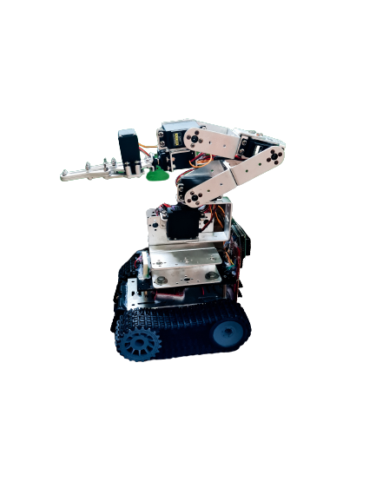
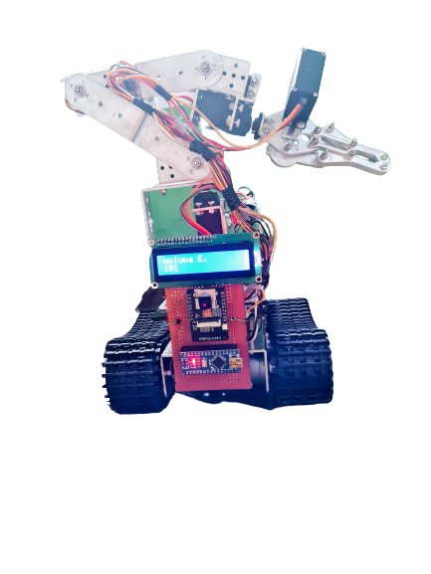
Meet ZetaBot

Slide 11
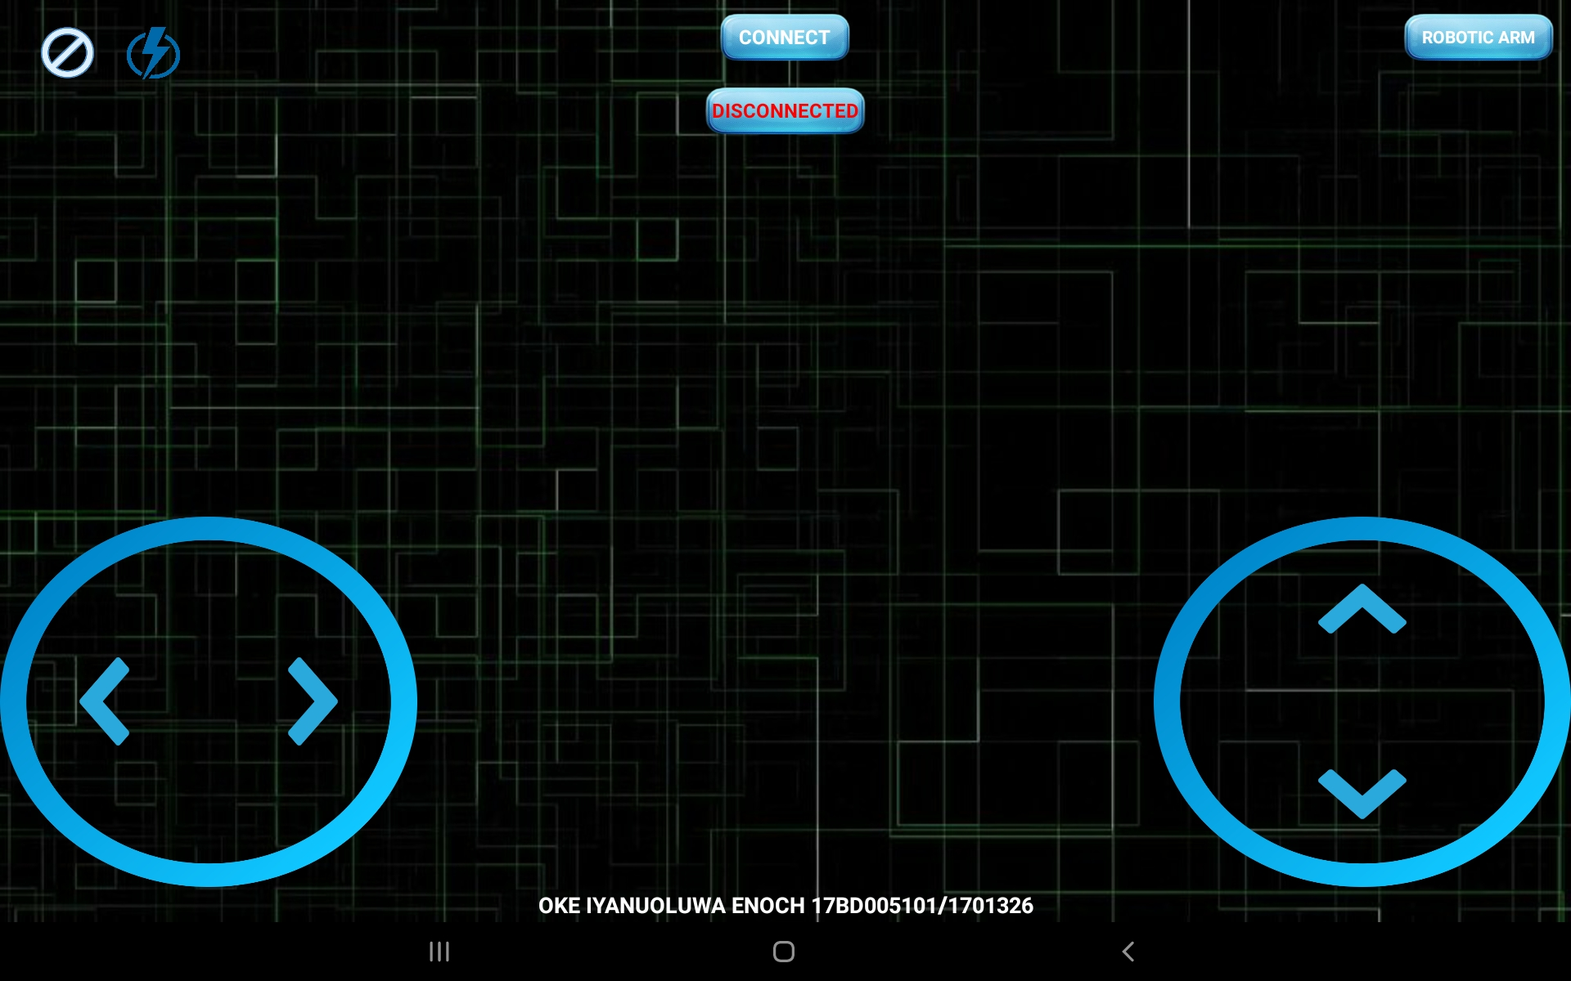
Tablet APP
(Tank Section)

Slide 12
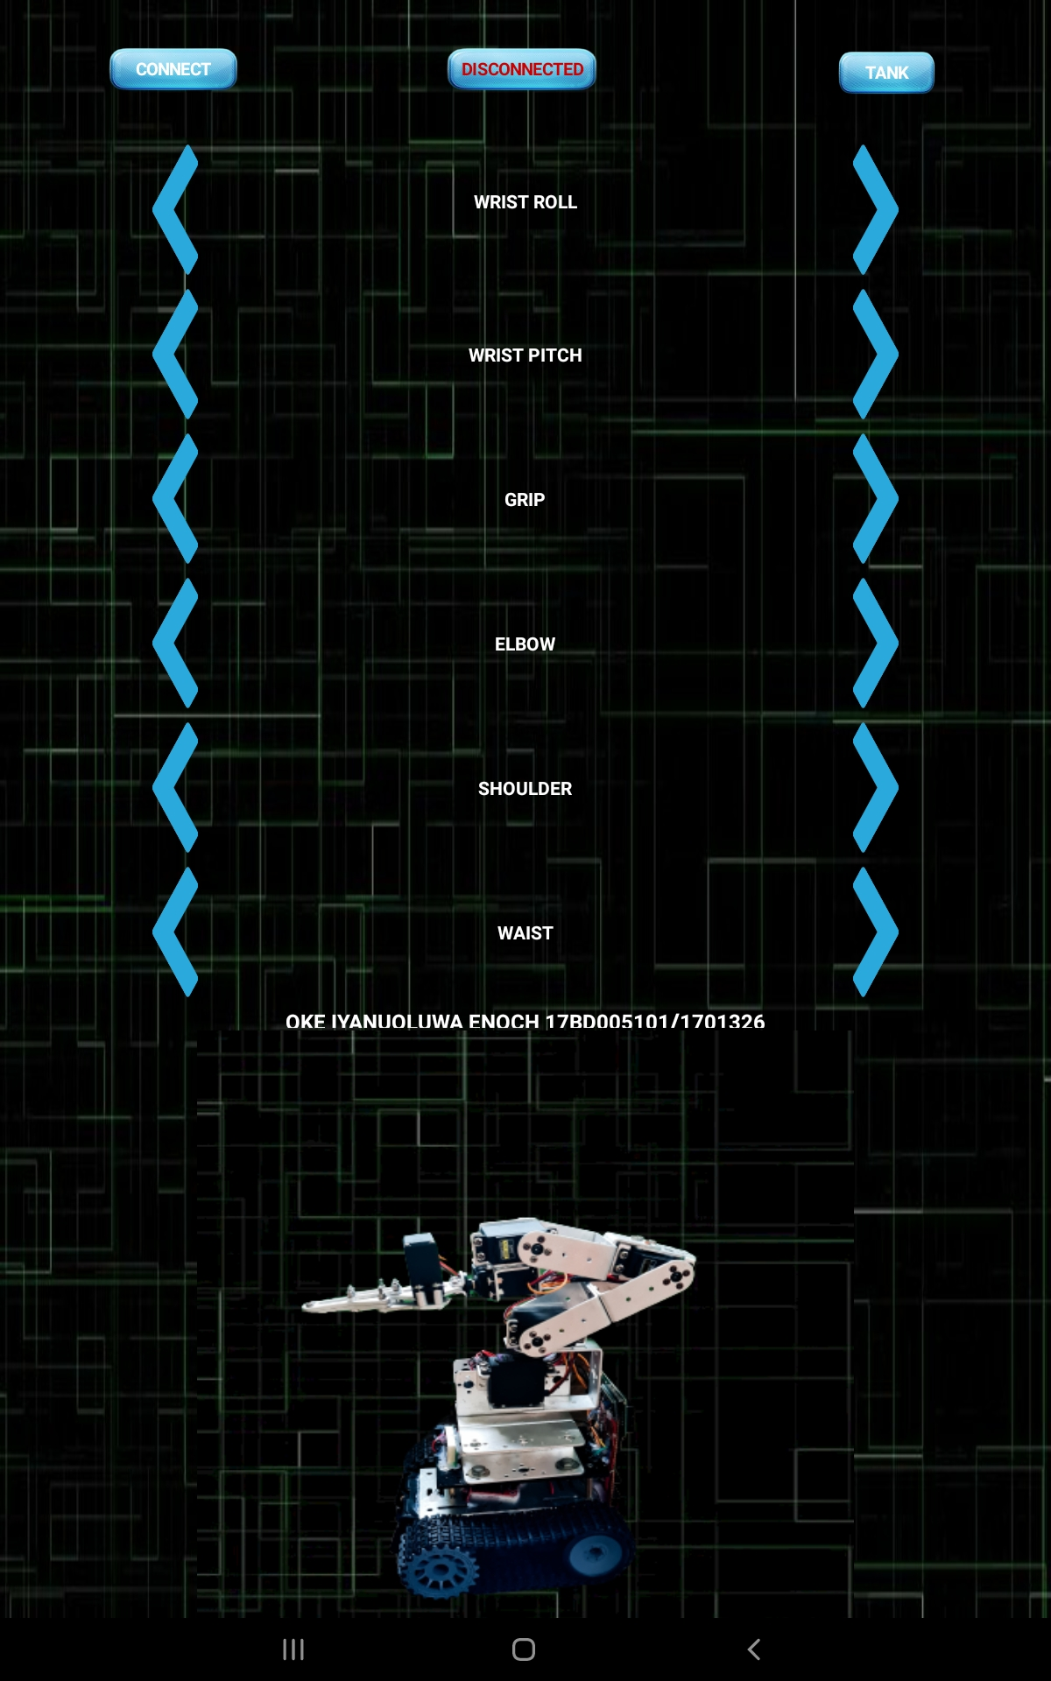
Tablet APP
(Arm Section)

Slide 13
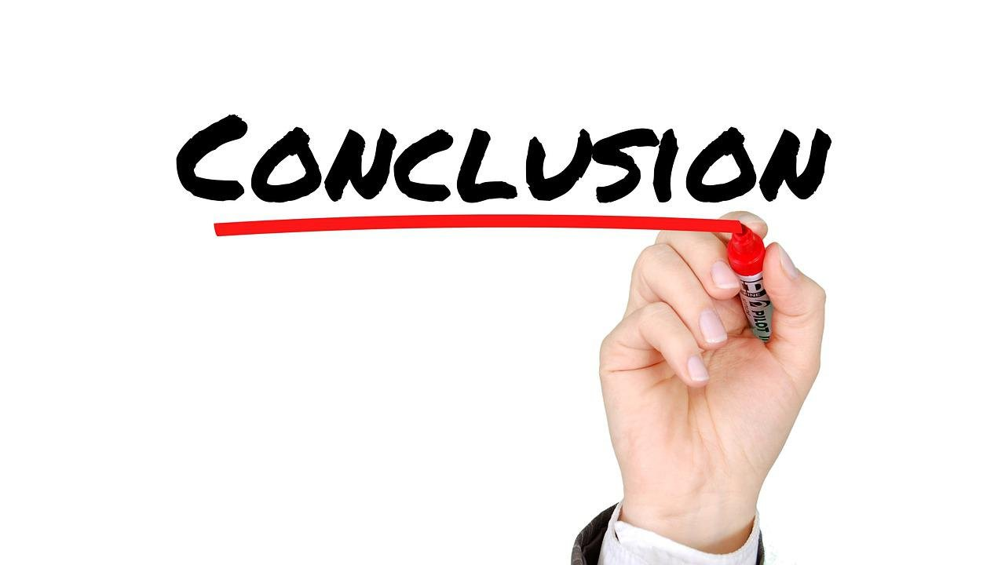
CONCLUSION
I successfully designed and implemented the proposed low-cost robot. The mobile app is user friendly and self-explanatory, once the mobile is connected to the robot is shows connected and the robot displaying a welcome message indicating the robot is still booting. With this project being designed and implemented, a user-friendly, scalable, open-source and low-cost agrotechnology is believed to have been achieved.
Although, the project was initially planned to be operated over the Internet instead of Bluetooth Connection, this was due to lack of strong internet and availability of materials need for the seamless transmission.

Slide 14
Thank You !

